Slide 1
Will Code For Food
Cru Central Coast Android Application

Slide 2
Features
Ministries
Events
Summer Missions
Ministry Teams
Resources
Ride Sharing
Home Page Feed

Slide 3
To Do
Community Groups
Resource Tags & Leader Resources
Write More Tests

Slide 4
Demo

Slide 5
Metrics
Coupling
Encapsulation Rate
Code Coverage

Slide 6
Coupling
Afferent Coupling: “responsibility” - how many package classes depend on you
Efferent Coupling: “dependence” - how many package classes you depend on
What We Want:
Low responsibility and dependence in our features
High responsibility and low dependence in model and common classes
Why?
Makes it easier to swap in and take out features
Notes:
Afferent: # of classes in other packages that depend on classes in this package; “incoming”
Efferent: # of classes in other packages that the classes in this package depend on; “outgoing”

Slide 7
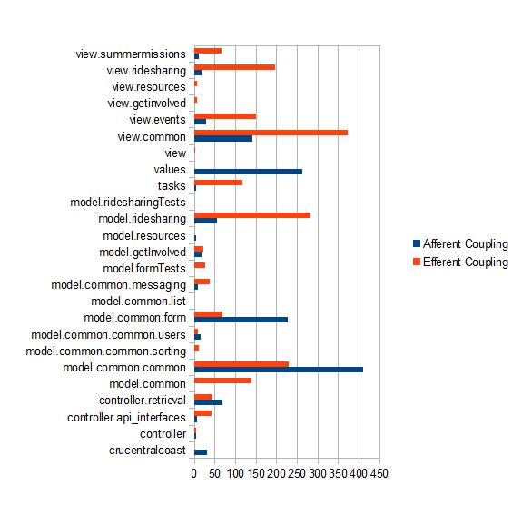
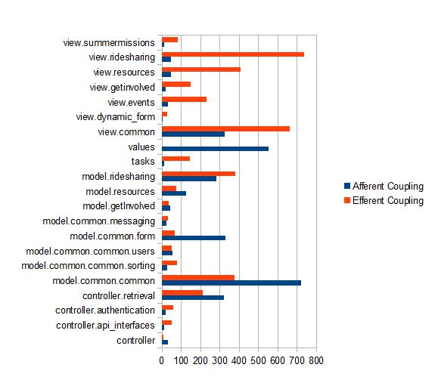
Coupling
Mid-Term
Current

Slide 8
Encapsulation Rate
How many classes are not used externally to the package
Midterm: 48.31%
Final: 54.61%
What We Want:
High encapsulation rate of main features
Why?
Makes it easier to swap out and in features

Slide 9
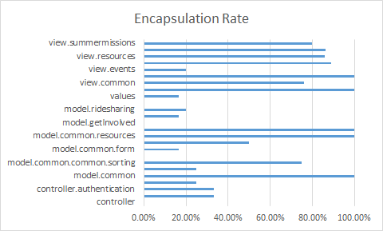
Encapsulation Rate

Slide 10
Code Coverage
The amount of our code covered by tests.
Midterm: 12% of methods, 6% of classes
Final: 12% of methods, 6% of classes
What We Want:
As much code coverage as possible
Why?
To ensure that the app behaves as expected

